Slide 1



Mersey and West Lancashire Teaching Hospitals NHS Trust
Library & Knowledge Service
Welcome

Slide 2
About Us

Slide 3

THE LIBRARIES
There are 3 Libraries at Mersey West Lancs
Whiston Library
Hanley Library
Sanderson Library
Nightingale House
Whiston Hospital
Warrington Road
Prescot
L35 5DR
Clinical Education Centre
Southport Hospital
Town Lane
Southport
PR8 6PN
Education Centre
Ormskirk Hospital
Wigan Road
Ormskirk
L39 2AZ
Monday - Thursday
9.00am - 5.00pm
Friday 9.00am - 4.30pm
Fully staffed
Monday - Friday
8.30am - 4.30pm
Fully staffed
Monday - Friday
8.30am - 4.30pm
Self-Service
24-hour access is available if you are a member of the Library

Slide 4
YOUR LIBRARY
  A bright and welcoming space
  PCs and printers
  Space to work
  Individual and team soundproofed Library Pods
  Large selection of books and other resources
  Professional and knowledgeable staff support

Slide 5

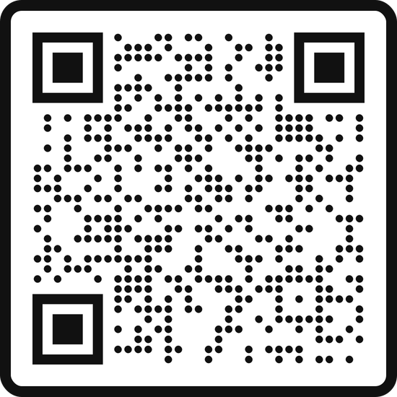
YOUR ONLINE LIBRARY
As well as coming to visit us, you can also access our resources online
Go to:
library.merseywestlancs.nhs.uk

Slide 6
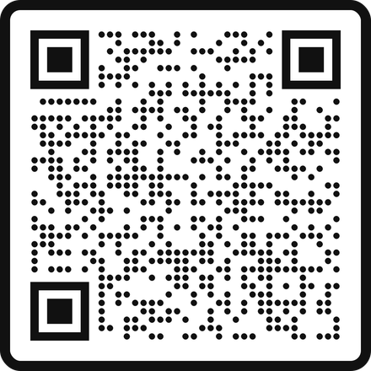


JOINING THE LIBRARY
Library membership is FREE and available to anyone working for, or on placement at, Mersey & West Lancs Teaching Hospitals NHS Trust
Becoming a member allows you to use and borrow from all 3 MWL Libraries as well as from other NHS Libraries in the North West
  Members can borrow up to 12 books at any time
  Books will auto-renew up to a maximum of 4 times
scan the QR Code here to fill out an online form, or visit your MWL Library to join

Slide 7
The Resources

Slide 8
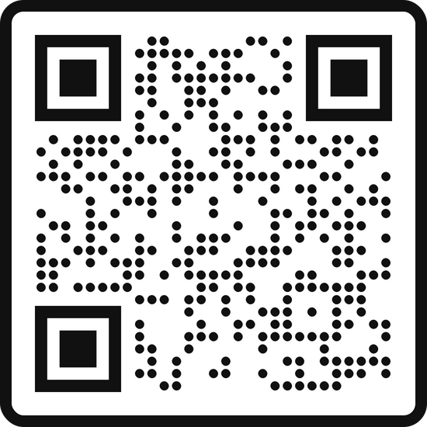
NHS ATHENS ACCOUNT
You will need an NHS OpenAthens Account to access any of our electronic resources
To sign up go to:
openathens.nice.org.uk

Slide 9
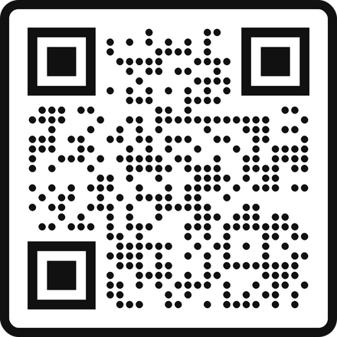

BOOKS & EBOOKS
We currently hold over 9000 books in stock, over all sites
You can also borrow any titles you need from other NHS Libraries in the NoW consortium
In addition we have thousands more available as eBooks
The online catalogue is available from the Library website
Over 200,000 titles currently available!
Scan the QR code for access

Slide 10
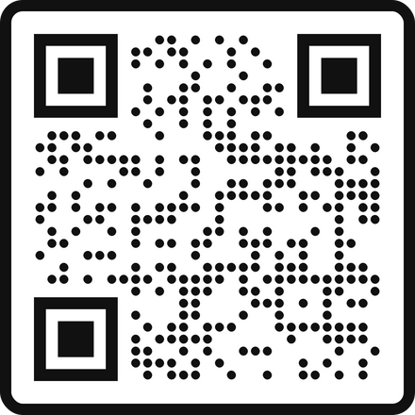
THE KNOWLEDGE & LIBRARY HUB
This is a single national gateway for all staff and learners in the NHS in England
It brings together ebooks, journal articles and much more into a single search
Or scan the QR code for access
It’s a great place to begin!
To access the Hub click on the link on the Library webpages

Slide 11
DATABASES AND OTHER ONLINE RESOURCES
The Library provides access to a host of key healthcare databases and online resources from a variety of providers
  Medline
  CINAHL
  Embase
  Cochrane Library
  HMIC
  BNF
  UpToDate
  Clinical Key
  BMJ Best Practice
  The Royal Marsden Procedures
And many more!
Access from the Library webpages

Slide 12
How We Can Support You

Slide 13
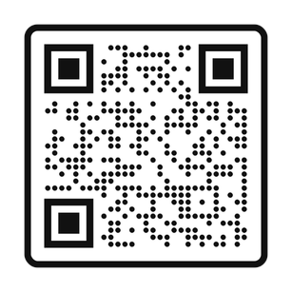
LITERATURE SEARCHING SERVICE
Let us save you time and effort!
We can conduct literature searches for you on any subject
We will search the available literature and compile a bibliography of sources for you
Simply complete a request form online or contact your Library to discuss your requirements

Slide 14
INFORMATION SKILLS TRAINING
The Library can offer training in finding and interpreting evidence-based information
Sessions include:
  Effective Literature Searching
  Finding the Best Evidence
  Critical Appraisal
  Reference Writing & Other Study Skills
Available in-person or via MS Teams
Training sessions are available in timetabled sessions, as one-to-one sessions or as bespoke group sessions to departments and teams

Slide 15
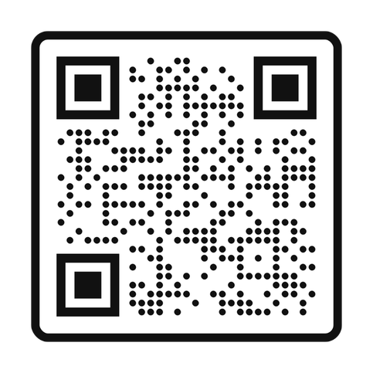
KNOWLEDGE SHARE
We can set up free, tailored current awareness alerts so you can get the latest information in your area of interest - straight to your inbox!
Sign up here or contact your Library

Slide 16
Contact Us

Slide 17




SOCIAL MEDIA
You can keep up to date with all things Library by following us on social media
@MWLNHSLibrary
Facebook
X
Instagram

Slide 18


CONTACT US
If you have any questions or need any help or advice, please contact your MWL Library Team
library@merseywestlancs.nhs.uk
0151 430 1342
Whiston and St Helens
01704 704202
Southport and Ormskirk

